Slide 1
http://www.vidyanidhi.com/
ketkiacharya.net@gmail.com
Ketki Acharya
From: SM VITA ATC of CDAC
9769201036
ketkiacharya.net@gmail.com
Sql server, .net and c# video tutorial: ASP.NET Core Tutorial for Beginners (csharp-video-tutorials.blogspot.com)

Slide 2
Why .NET Core?
There are some limitations with the .NET Framework. For example, it only runs on the Windows platform. Also, you need to use different .NET APIs for different Windows devices such as Windows Desktop, Windows Store, Windows Phone, and Web applications. In addition to this, the .NET Framework is a machine-wide framework. Any changes made to it affect all applications taking a dependency on it. Learn more about the motivation behind .NET Core here.
Today, it's common to have an application that runs across devices; a backend on the web server, admin front-end on windows desktop, web, and mobile apps for consumers. So, there is a need for a single framework that works everywhere. So, considering this, Microsoft created .NET Core. The main objective of .NET Core is to make .NET Framework open-source, cross-platform compatible that can be used in a wide variety of verticals, from the data center to touch-based devices.

Slide 3
NET Core Characteristics
Open-source Framework: .NET Core is an open-source framework maintained by Microsoft and available on GitHub under MIT and Apache 2 licenses. It is a .NET Foundation project.
You can view, download, or contribute to the source code using the following GitHub repositories:
Language compiler platform Roslyn: https://github.com/dotnet/roslyn
.NET Core runtime: https://github.com/dotnet/runtime
.NET Core SDK repository. https://github.com/dotnet/sdk
ASP.NET Core repository. https://github.com/dotnet/aspnetcore
Cross-platform: .NET Core runs on Windows, macOS, and Linux operating systems. There are different runtime for each operating system that executes the code and generates the same output.
Consistent across Architectures: Execute the code with the same behavior in different instruction set architectures, including x64, x86, and ARM.
Wide-range of Applications: Various types of applications can be developed and run on .NET Core platform such as mobile, desktop, web, cloud, IoT, machine learning, microservices, game, etc.
Supports Multiple Languages: You can use C#, F#, and Visual Basic programming languages to develop .NET Core applications. You can use your favorite IDE, including Visual Studio 2017/2019, Visual Studio Code, Sublime Text, Vim, etc.
Modular Architecture: .NET Core supports modular architecture approach using NuGet packages. There are different NuGet packages for various features that can be added to the .NET Core project as needed. Even the .NET Core library is provided as a NuGet package. The NuGet package for the default .NET Core application model is Microsoft.NETCore.App.
This way, it reduces the memory footprint, speeds up the performance, and easy to maintain.
CLI Tools: .NET Core includes CLI tools (Command-line interface) for development and continuous-integration.
Flexible Deployment: .NET Core application can be deployed user-wide or system-wide or with Docker Containers.
Compatibility: Compatible with .NET Framework and Mono APIs by using .NET Standard specification.

Slide 4
Version | Latest Version | Visual Studio | Release Date | End of Support
.NET 5 | Preview 1 | VS 2019 | 16th March, 2020
.NET Core 3.x - latest | 3.1.3 | VS 209 | 24th March, 2020 | 12th March, 2022
.NET Core 2.x | 2.1.17 | VS 2017, 2019 | 24th March, 2020 | 21st August, 2021
.NET Core 1.x | 1.1.13 | VS 2017 | 14th May, 2019 | 27th May, 2019
Both, .NET 3.1, and .NET Core 2.1 will have long term support.
.NET Core 3.x applications only run on .NET Core Framework.
.NET Core 2.x applications run on .NET Core as well as .NET Framework.

Slide 5
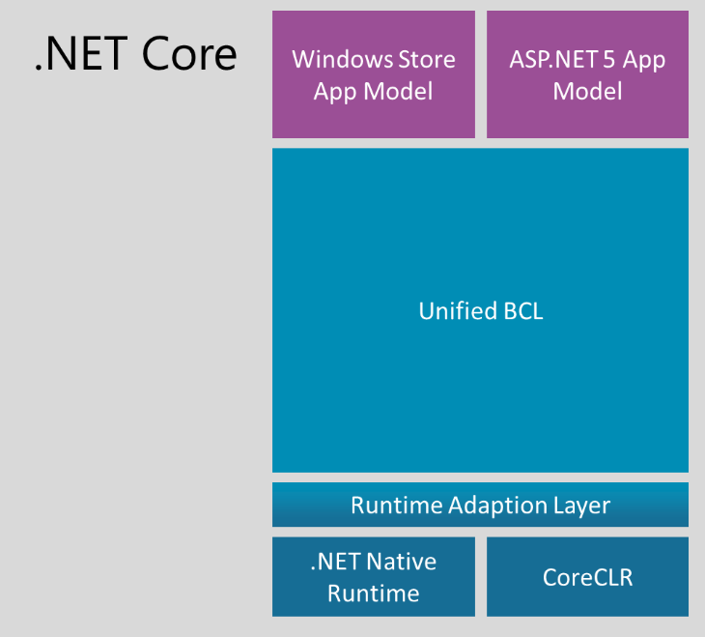
NET Core Composition
The .NET Core Framework composed of the following parts:
.NET Core
CLI Tools: A set of tooling for development and deployment.
Roslyn: Language cmpiler for C# and Visual Basic
CoreFX: Set of framework libraries.
CoreCLR: A JIT based CLR (Command Language Runtime).

Slide 6
.NET Core can be installed in two ways: By installing Visual Studio 2017/2019 or by installing . NET Core Runtime or SDK.
.NET Core installer already contains ASP.NET Core libraries, so there is no separate installer for ASP.NET Core.
Install Visual Studio
Currently, .NET Core 2.1 and .NET Core 3.1 is having long term support. Visual Studio 2017 supports .NET Core 2.1, whereas Visual Studio 2019 supports both the versions.
You can use your favorite IDE, such as Visual Studio, Visual Studio Code, Sublime Text, etc. to develop, restore, build, and run .NET Core application. Here, we will use Visual Studio 2019.
If you dont have Visual Studio on your development PC, then it is recommended to install the latest Visual Studio 2019. If you already have either Visual Studio 2017 or 2019, then you already have installed .NET Core 2.1.
Download and install Visual Studio 2019 based on your OS from here. Select the appropriate edition as per your license. The community edition is free for students, open-source contributors, and individuals.
During installation, select ".NET Core cross-platform development" workload. This will install .NET Core 2.1. However, you need to install .NET Core 3.1 SDK separately.
Once installed, you can verify it by opening a command prompt (or terminal in Mac) and type dotnet --version and press Enter. This will display the installed version and usage information, as shown below.
C:\Users\dev>dotnet --version
2.1.805

Slide 7
Software Required
There are 2 software that we need to install for .net core application development.
Editor
.NET Core SDK (Software Development Kit)
Download and install .NET Core SDK Navigate to https://dotnet.microsoft.com/download
Depending on the operating system you have, download and install the SDK.
The SDK includes everything you need to build and run .NET core applications.
The .NET Core Runtime is already included in the SDK. So, if you have installed the SDK, there is no need to install .NET Core Runtime
The .NET Core Runtime includes just the resources required to run existing .NET Core applications.

Slide 8
Install .NET Core 3.x
As you have seen, Visual Studio 2019 installer includes .NET Core 2.1 but not .NET Core 3.x. You need to install it separately.
To download the latest version of .NET Core, go to https://dotnet.microsoft.com/download and select the platform you are using.
As you can see above, .NET Core Runtime and .NET Core SDK are different things. .NET Core Runtime is only used to run .NET Core application, whereas .NET Core SDK includes tools and libraries to develop .NET Core applications. To set up a development environment, we need to install .NET Core SDK for the platform we use for development such as Windows, Linux, or Mac. Here we will install .NET Core SDK because we are preparing a development environment for building .NET Core applications. If you are aiming to run .NET Core application, then install .NET Core Runtime on your server or cloud or client desktop.
Click on the Download .NET Core SDK button to download the latest version of .NET Core SDK installer. It will download .NET Core 3.1 SDK as of this writing.
After downloading the installer, click on it to start the installation.

Slide 9
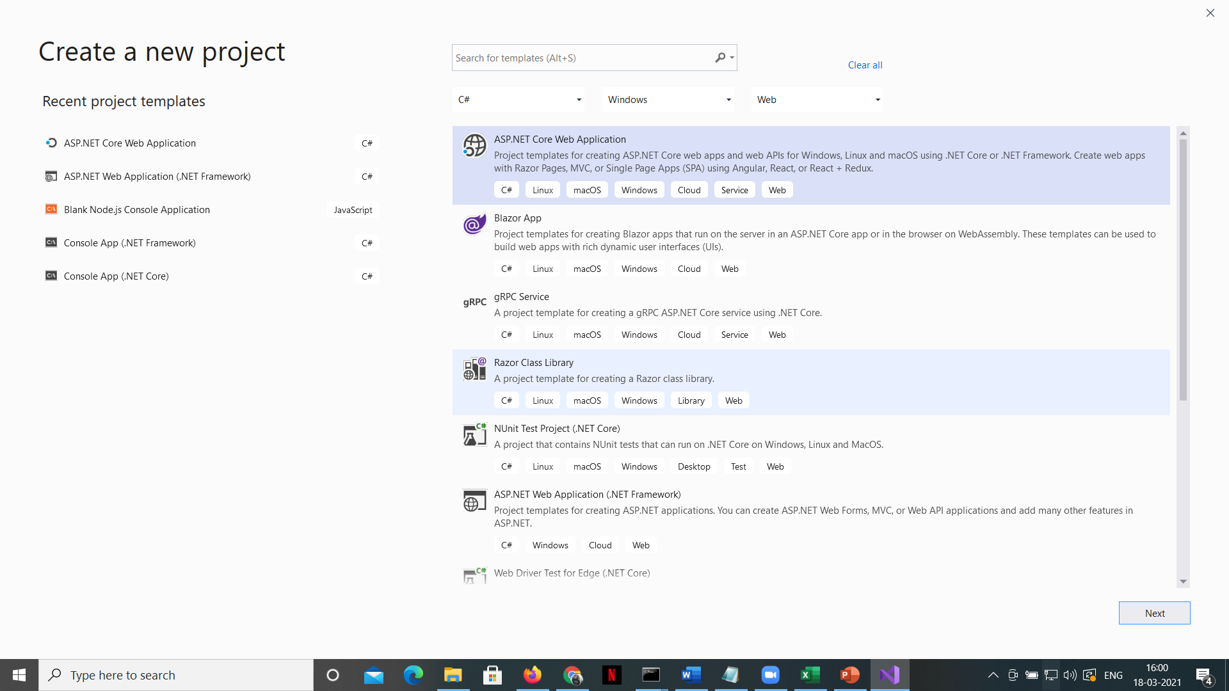
Start new project

Slide 10
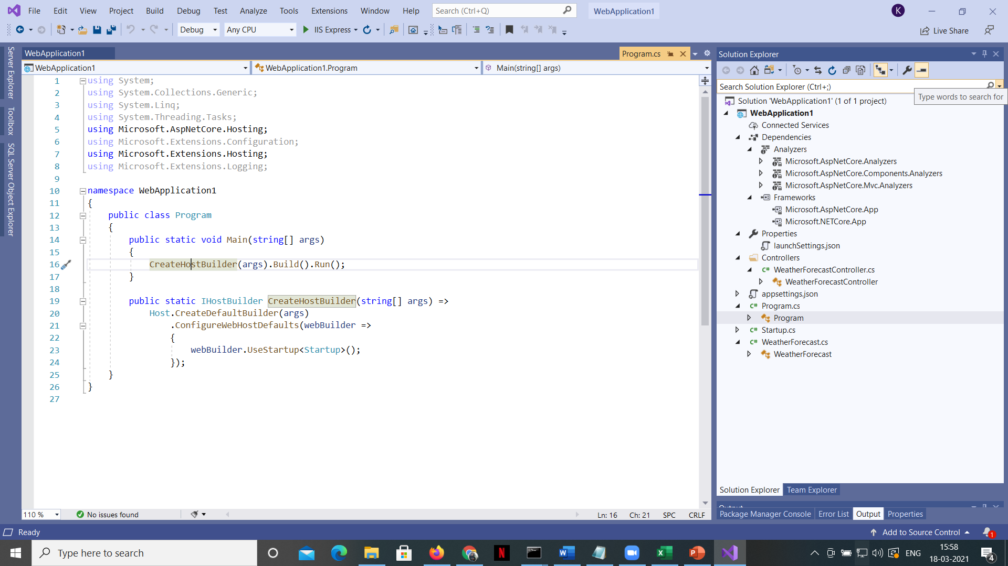

Slide 11
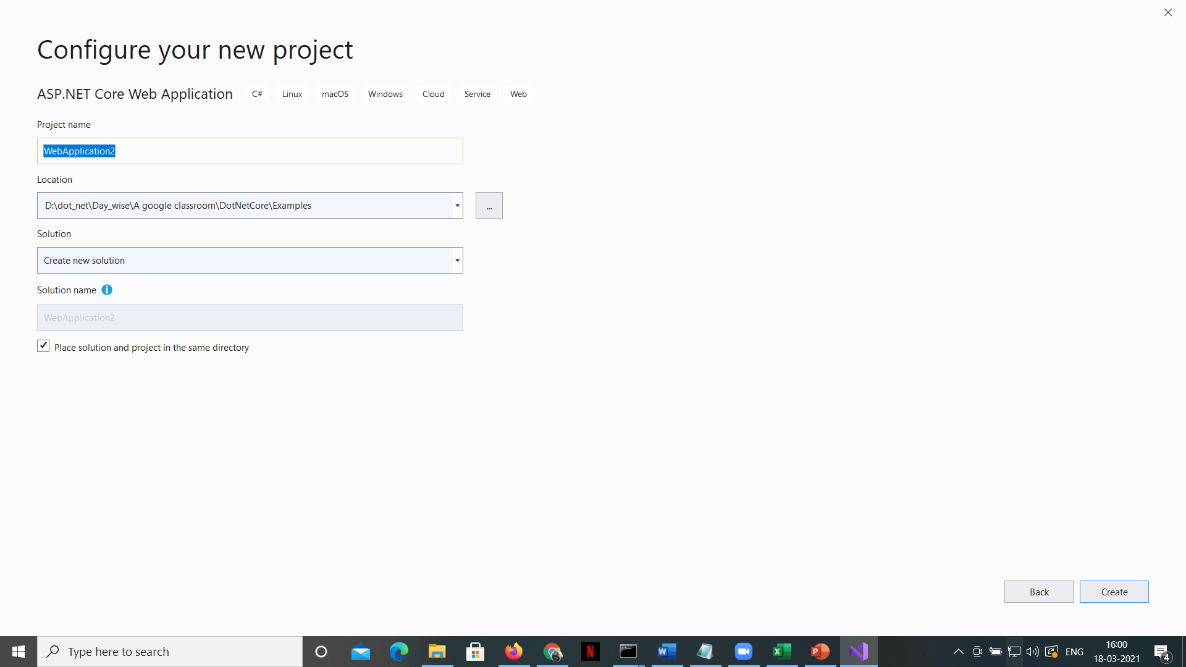

Slide 12
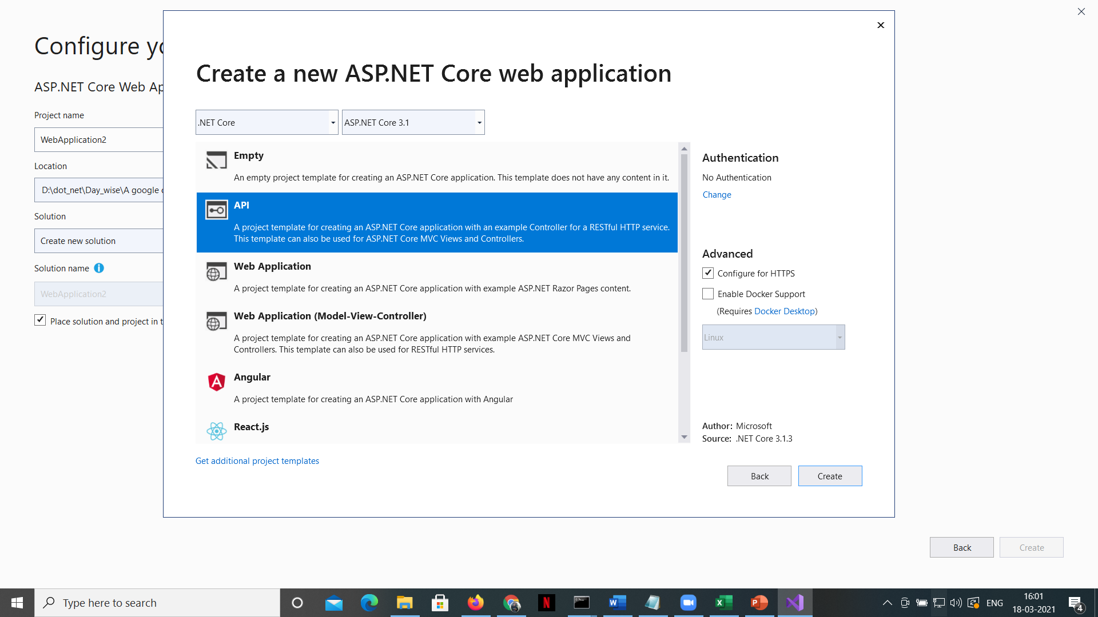

Slide 13
Well, the important point to keep in mind is that, an asp.net core application initially starts as a console application and the Main() method in Program.cs file is the entry point.
So, when the runtime executes our application it looks for this Main() method and this where the execution starts.
This Main() method configures asp.net core and starts it and at that point it becomes an asp.net core web application.
So, if you take a look at the Main() method, it calls CreateWebHostBuilder() method passing it the command line arguments.
As you can see, CreateWebHostBuilder() method returns an object that implements IWebHostBuilder.
On this object, Build() method is called which builds a web host that hosts our asp.net core web application.
On the web host Run() method is called, which runs the web application and it begins listening for incoming HTTP requests.
CreateWebHostBuilder() method calls CreateDefaultBuilder() static method of the WebHost class.
CreateDefaultBuilder() method creates a web host with pre-configured defaults. CreateDefaultBuilder() method does several things to create a web host. We will discuss all that the CreateDefaultBuilder() method does in detail in our next video. For now, just understand that the CreateDefaultBuilder() method sets up a web host with certain defaults.
As part of setting up a web host, Startup class is also configured using the UseStartup() extension method of IWebHostBuilder class. If you are new to the concept of extension methods, please check out the following video.

Slide 14
using System;
using System.Collections.Generic;
using System.Linq;
using Microsoft.AspNetCore.Mvc;
using Microsoft.Extensions.Logging;
namespace WebApplication2.Controllers
{
[ApiController]
[Route("[controller]")]
public class WeatherForecastController : ControllerBase
{ private static readonly string[] Summaries = new[]
{ "Freezing", "Bracing", "Chilly", "Cool", "Mild", "Warm", "Balmy", "Hot", "Sweltering", "Scorching"
};
private readonly ILogger<WeatherForecastController> _logger;
public WeatherForecastController(ILogger<WeatherForecastController> logger)
{ _logger = logger; }
[HttpGet]
public IEnumerable<WeatherForecast> Get()
{ var rng = new Random();
return Enumerable.Range(1, 5).Select(index => new WeatherForecast
{ Date = DateTime.Now.AddDays(index),
TemperatureC = rng.Next(-20, 55),
Summary = Summaries[rng.Next(Summaries.Length)]
}) .ToArray();
}
}
}

Slide 15
The controller class and its method define the endpoint and its behavior. The [Route] and [HttpGet] attributes tell ASP.NET to route an HTTP GET method request to the path /weathterforecast to the Get() method for processing, which returns an IEnumerable<WeatherForecast>. As we saw in our first run, that return value gets converted into a JSON array, the response we saw in the browser.
Out of the box, ASP.NET Core 3.1 uses the new System.Text.Json.JsonSerializer to convert C# objects to (and from) JSON, instead of the long-time mainstay Json.NET (or Newtonsoft.Json). From a performance and dependency perspective, System.Text.Json was a major foundation of .NET Core 3.1 and its integration with ASP.NET Core 3.1. We’ll learn more on how to use the new serialization later.

Slide 16
The ConfigureServices() method is where you do service registration with the IServiceCollection (think dependency injection root).
AddControllers() is the Web API middleware which will register all the controllers (classes derived from ControllerBase).
NOTE: AddControllers() is the lighter weight Web API version of MVC’s AddControllersWithViews() or AddRazorPages() or AddMvc() in that it does not register services used for views and pages, which would be useful for a user-facing ASP.NET Core MVC web application.
UseRouting() and UseEndpoints() are the key configuration elements that add to ASP.NET’s middleware pipeline decision points for routing (as defined by attributes like [Route()] and [HttpGet] we saw in the controller class).

